Slide 1
COMPUTE Virtual Server Reboots (End to END)
Mar 2021

Slide 2
Summary
Problem Avoid Manual Intervention from Sys Admin for virtual server reboot request. Reduction in request tickets received for action. Requestor : Laura K Franzen-Elmer and Craig Lewandowski Developer : Mohankumar Ganesan SME : Laura K Franzen-Elmer(Compute) , Ravish Shetty (SNOW) , Debnath Singh(SNOW)
Solution End to End Automation that eliminates human Intervention in Client Upgrades. User Interface Catalog from SNOW to Intake the request. Find the Platform Owners\RBU Owner for Reboot Approvals Perform Pre validations of server Deploy a Standard change. Perform Reboot of server and Post validations Close the Change , Request and Notify the requestor. On failure create Problem , Incident and Close the task with necessary comments and closure codes.
Benefits Unit value: ~10 minutes STP value: ~40 daily (~800 monthly) Efficiency: ~140hrs monthly consevative

Slide 3
End to End Virtual Server Reboot Automation Workflow
SNOW catalog For Virtual server Reboot
Server Name for Reboot (Single, Multiple)
Reason for Reboot
Scheduled \ Immediate
Note: A notification will be sent to Platform
owners for approval. The server will be rebooted
post their approval
Managed by Resolve
Pre-Validate Server to make
sure, Server can be managed
via Resolve
The RITM will create an Approval Task
for Platform owner’s approval
Start
Valid?
Deploy GTO – Server Reboot STD
change and notify the user with
change number as server is not
candidate for Automation.
Approved?
Approved
Immediate?
END
Not Managed by Resolve
Immediate
Scheduled
notify the user that request has
been Cancelled as Platform
team not approved due to Reason
specified in comments
Deploy standard Change
that is created for
Automation Efforts
Deploy standard Change with
Scheduled time that is created for
Automation Efforts
Not Approved
Tasks Auto Assigned and
accepted for GITS Automation
Implementation
Validation
Tasks Auto Assigned and
accepted for GITS Automation
Implementation
Validation
Validation Failure (Close Implementation task as successful)
Cause category : Script Issue (Post Automation Validation )
What went wrong? Validation failed after Resolve execution
What was the client impact? Copy this from “Reason for Reboot”
What’s our next step? Create a P2 incident and alert the on call
support team (Notification Call, Email and Message to On call)
Problem Ticket for the support team to figure out why a standard
execution caused issues. This is critical as it is grounds for revoking
the standard change by CM.
Reboot failure without Impact (Server Reboot didn't apply Properly)
(Implementation\validation)
Cause category : Script Issue (Automation)
What went wrong? Resolve issue, failed to execute
What was the client impact? Copy this from “Reason for Reboot”
What’s our next step? Create a P3 incident, alert the on call and
reboot manually if still within window(Notification Email and Message to
On call)
Problem Ticket for GITS Automation for Root Cause Analysis
Implement?
Validation Failure
Implementation Failure
Implementation
Close the Validation Task, Change
request and the RITM by
Notifying the user that request has
been Completed
Close Implementation task as
successful and perform
post validation
Resolve Connects to vCenter
and Reboots the server and
resolve monitor the
vCenter task for completion
Success?
Success?
Validation
Successful
Implementation
Successful

Slide 4
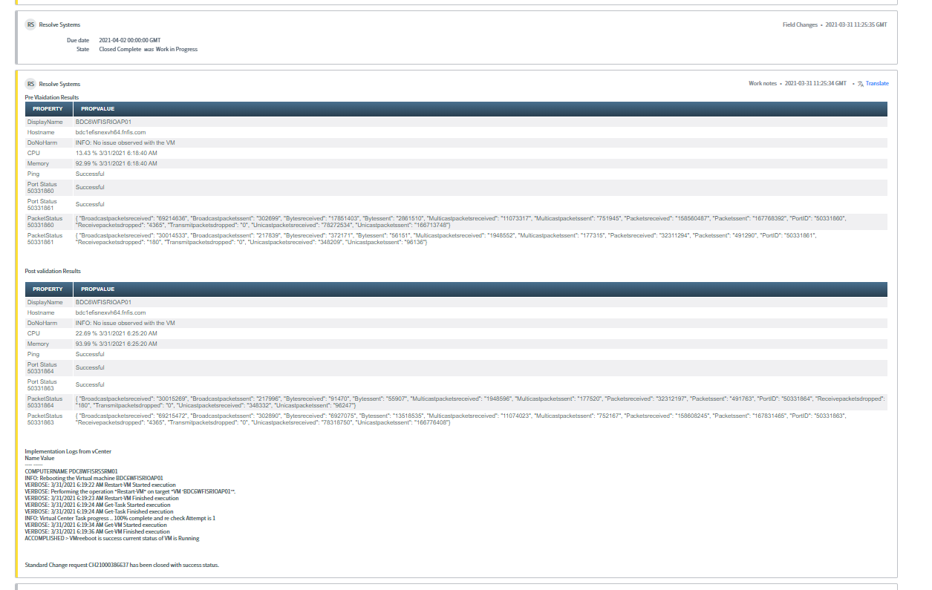
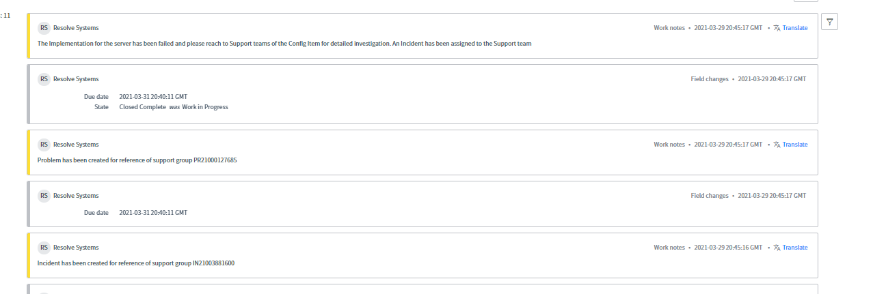
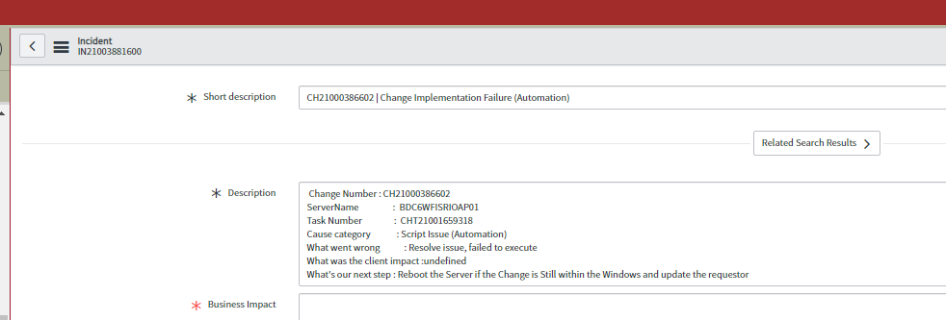
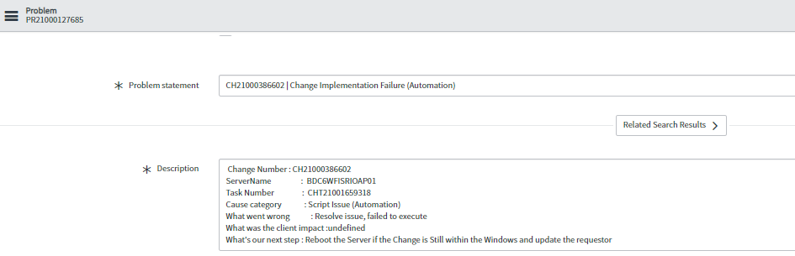
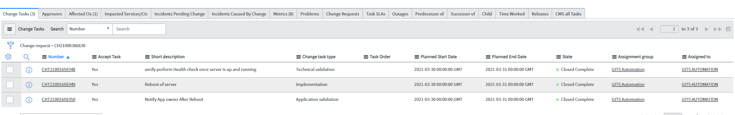
Results
Successful completion
Failed Execution
Change closures

Slide 5
Thank You!

